Slide 1
Project #2: Visualize Me, Captain!
Lesson 18.1

Slide 2
Your Task

Slide 3
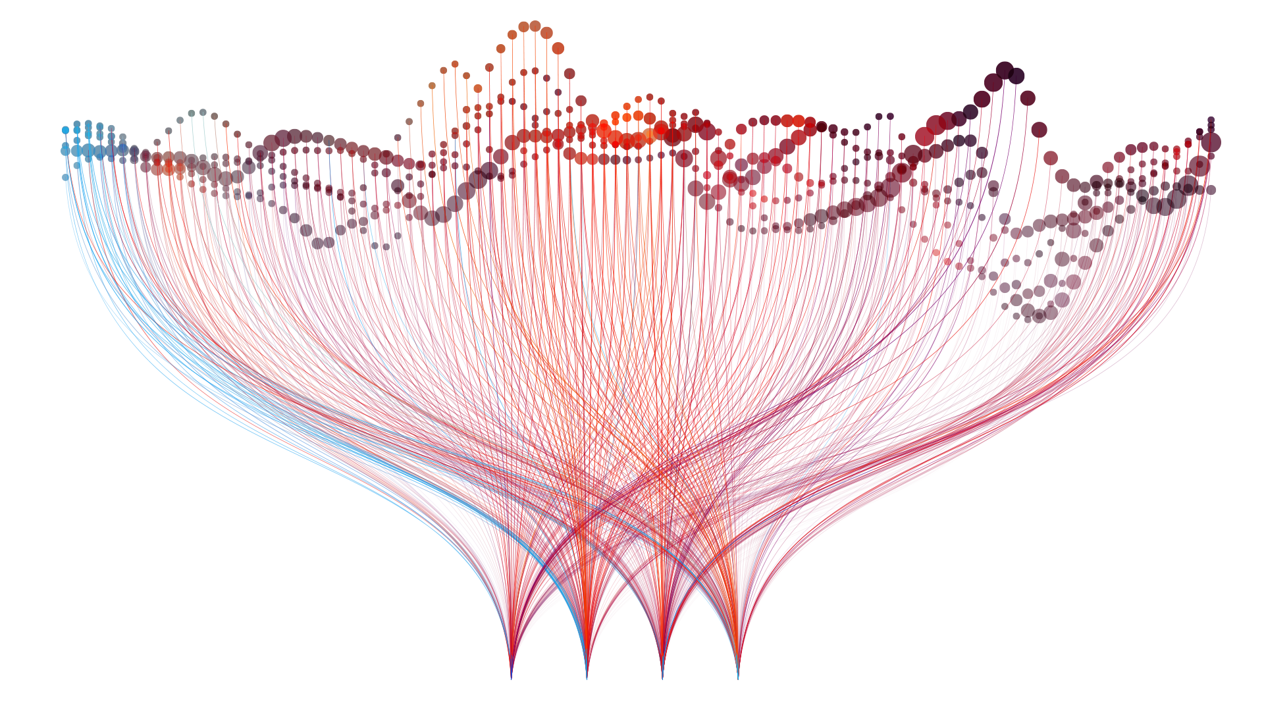
Tell a Story with Data
Notes:
AdobeStock_159567645

Slide 4
Project Requirements

Slide 5
Project Description
Your task is to tell a story through data visualizations.
Focus on providing users an interactive means to explore data themselves.
Prepare a 10-minute presentation that lays out your theme, coding approach, data munging techniques, and final visualization. (NOTE: potentially going to be 15 minute presentations. Will keep you posted on this)
You may choose a project of any theme, but we encourage you to think broadly.
You will have ample time in class to work with your group, but expect to put in hours outside of class as well.

Slide 6
Specific Requirements
Your project deliverable: An interactive Flask-powered dashboard with multiple charts that update from the same data.
Your project must include a Python Flask RESTful API, HTML/CSS, JavaScript, and at least one database (PostgreSQL, MongoDB, etc.) (Try to use SQLite as a last resort)
At least one of your charts must be D3 or Leaflet.
Project must be deployed to Heroku.
Your project should include at least one JS library that we did not cover.
Your project must be powered by a data set with at least 100 records.
Your project must include some level of user-driven interaction (e.g., menus, dropdowns, textboxes).
Your final visualization should ideally include at least three views.

Slide 7
Viable architecture design
Python
JavaScript, HTML, CSS
Flask App
1. Read data from source
jsonify()
5. Expose data as JSON API
6. Read JSON API using JavaScript
7. Additional data preparation
8. Visualize and deploy into web dashboard
2. Preliminary preprocessing or analysis
4. Query database
3. Store in persistent database
Flask route navigates user to HTML UI, which triggers JavaScript
Notes:
Data url: https://www.google.com/imgres?imgurl=https%3A%2F%2Fcdn3.iconfinder.com%2Fdata%2Ficons%2Felastic-search-line%2F128%2FElastic_Search_-_Line-05-512.png&imgrefurl=https%3A%2F%2Fwww.iconfinder.com%2Ficons%2F4665701%2Fdata_data_source_database_elastic_search_search_data_icon&tbnid=dqN_fINWpMsvQM&vet=12ahUKEwi2xK-71sjnAhVGa6wKHXXYATEQMygAegUIARCBAg..i&docid=wfCWf4QNJdT3VM&w=512&h=512&q=data%20icon&ved=2ahUKEwi2xK-71sjnAhVGa6wKHXXYATEQMygAegUIARCBAg
Database: https://static.thenounproject.com/png/9658-200.png
Api: https://static.thenounproject.com/png/410844-200.png
Data preprocessing: https://cdn4.iconfinder.com/data/icons/internet-of-things-34/66/10-512.png
Javascript: https://cdn.iconscout.com/icon/free/png-256/javascript-20-555998.png
Data visualization: https://pngimage.net/wp-content/uploads/2018/06/graph-button-png-2.png

Slide 8
Schedule

Slide 9
Weekly Schedule
Sun | Mon | Tue | Wed | Thu | Fri | Sat
22
23
24
25
26
27
28
Web Deployment
Project 2
No Class
No Class
29
30
1
Optional: R
Project Work
Proposals Due
D3 HW Due
2
3
4
5
Optional: R
Project Work
Project Work
6
7
8
9
10
11
12
Project Work
Leaflet HW Due
Project Work
Project
Presentations

Slide 10
Weekly Schedule
11/24 (Today):
Create a repository for your team and MAKE SURE EVERYBODY HAS ACCESS TO CONTRIBUTE
Brainstorm with your group potential ideas and focus on:
Selecting a topic
Finding a data set
Finding inspiration
“Sketching” your ideal visuals
Creating a 1-page proposal
12/1 (Next Tuesday): You will need to create a 1-page proposal that includes:
A brief articulation of your chosen topic and rationale
A link to your data set(s) and a screenshot of the metadata if it exists.
3 or 4 screenshots of relevant, “inspiring” visualizations that frame your creative fodder
A sketch of the final design
A link to the primary GitHub repository you’ll be housing your work in

Slide 11
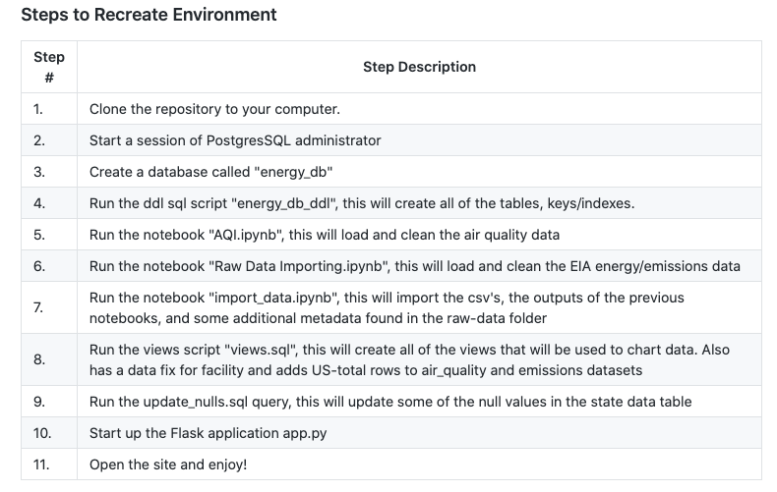
Final Repository
Your team’s final repository must be well organized.
It must contain:
Commits from every person on the team
Description of the project
Name of team members
Detailed instructions on how to recreate your environment and database (with scripts)
Link to your deployment
Entire Flask application
Entity Relation Diagram of your database
Any notable (organized) notebooks or python scripts used to create database or perform
Example Instructions:

Slide 12
Final Thoughts
Project week is a great time to tie up loose ends, both with your group and on your own.
If there are topics you’d like to review, shoot me and the TAs a message. We’re happy to do (recorded) extra review sessions for small groups during these weeks.
Good luck and have fun!

Slide 13
Groups

Slide 14
Project 2 Groups
Group 1 | Jeremy | Gabriel A | Debra | Chad | Nick
Group 2 | Alex | Jinah | Emeka | Pankaj
Group 3 | Rob | Kaylon | Tobias | Behrouz
Group 4 | Corey | Igor | Christy | Germaine
Group 5 | Sadie | Jennifer | Michael | Anthony
Group 6 | Reza | Katy | Radhika | Nicole
Group 7 | Yushan | Gabriel P | Joshua R | Janette
Group 8 | Jocelyn | Andres | Gina | Javier
Group 9 | Kimberly | Samuel | Kiran | Charles
Group 10 | David | Patricia | Josh B | Roberto
Group 11 | Vincent | Tia | Krishna | Sylvester
Group 12 | Justin | Sam | Shimsy | Zhanna
*The order of groups and members means nothing. They’ve been intentionally shuffled.

Slide 15
Questions?

